Slide 1


Slide 2

https://www.sih.gov.in/sih2023PS

Slide 3

Basic Details of the Team and Problem Statement
Ministry/Organization Name/Student Innovation:
Sri Vasavi engineering college
PS Code: SIH1360
Problem Statement Title: Student droupout Analysis for school education
Team Name:
Team Leader Name:K.Harshitha Lakshmi
Institute Code (AISHE): C-18129
Institute Name: Sri Vasavi engineering college
Theme Name:Smart Education

Slide 4
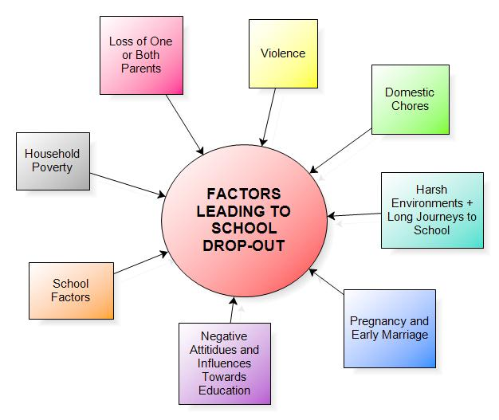
Idea/Approach Details
Describe your idea/Solution/Prototype here:
There are many strategies that can help prevent student dropout, such as mentoring
Programs, and career readiness initiatives.
Government also make syatematic analysis by targeting high dropout rates at the school,
Regional, gender, caste, and age/standard levels policymakers can work towards reducing
Disparities and ensuring that all students have equal access to quality education.
Describe your Technology stack here:
HTML, CSS, JAVASCRIPT
Python libraries( numpy,pandas,mysql.connector)
Frame work (flask)
MySQL database
Google chart

Slide 5
Idea/Approach Details
Describe your Use Cases here
Describe your Dependencies / Show stopper here
Better Futures: Lower dropout rates mean more students can have brighter, more successful futures.
Stronger Communities: Education helps create safer,healthier, and more united neighborhoods
Economic Growth: More educated individuals contribute to a stronger economy
Global Progress: Tackling dropout rates aligns with global goals, making the world a better place.
Datacleaning and processing
Numpy,pandas
Data visualization
Html(using google charts)
css
javascript

Slide 6
Team Member Details
Team Leader Name: Kotta Harshitha Lakshmi
Branch (Btech/Mtech/PhD etc): Stream (ECE, CSE etc): CSE Year (I,II,III,IV): III
Team Member 1 Name: Meka Daiva Krupa
Branch (Btech/Mtech/PhD etc): Stream (ECE, CSE etc):CSE Year (I,II,III,IV): III
Team Member 2 Name: Shaik Suhana
Branch (Btech/Mtech/PhD etc): Stream (ECE, CSE etc): CSE Year (I,II,III,IV): III
Team Member 3 Name: Allam Mownika Sri Divya
Branch (Btech/Mtech/PhD etc): Stream (ECE, CSE etc): CSE Year (I,II,III,IV) : III
Team Member 4 Name: Tangella Pavan Kumar
Branch (Btech/Mtech/PhD etc): Stream (ECE, CSE etc): CSE Year (I,II,III,IV): III
Team Member 5 Name: Pinninti Bhargava Sai
Branch (Btech/Mtech/PhD etc): Btech Stream (ECE, CSE etc): CSE Year (I,II,III,IV): III
Team Mentor 1 Name: G.Sriramganesh
Category (Academic/Industry): Expertise (AI/ML/Blockchain etc): Domain Experience (in years):

Slide 7
Important Pointers
Please ensure below pointers are met while
Kindly keep the maximum slides limit to 4 pages
All the topics should be utilized for description of your idea
Try to avoid paragraphs and post your idea in points
Keep your explanation precisely and easy to understand
Idea should be unique and novel. If it has a business potential more weightage will be given.
Apart from this PPT abstract of your idea will be asked separately while submitting
You need to save the file in PDF and upload the same on portal. No PPT, Word Doc or any other format will be supported
You can delete this slide (Important Pointers) when you upload the details of your idea on SIH portal.

Slide 8



